Slide 1
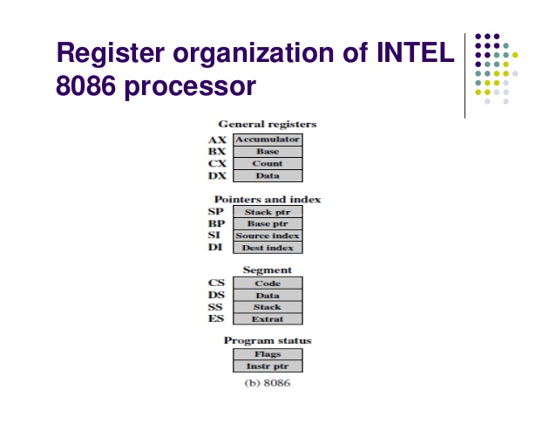

Slide 2
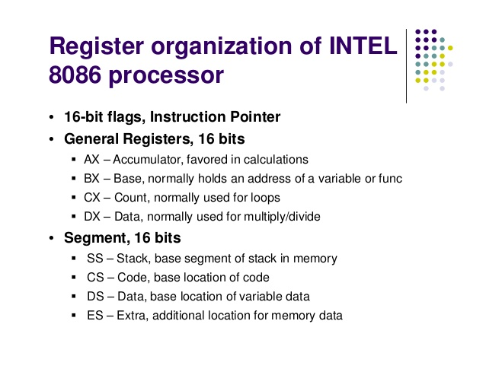

Slide 3
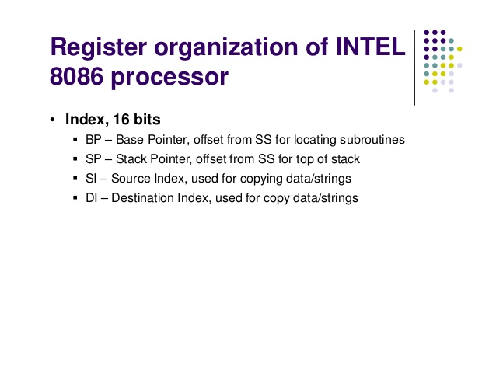

Slide 4
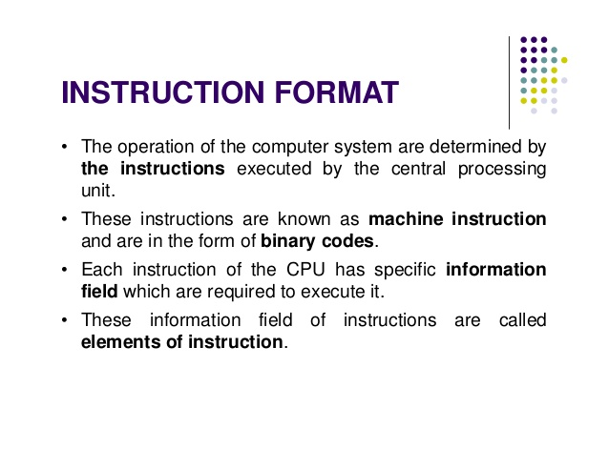

Slide 5
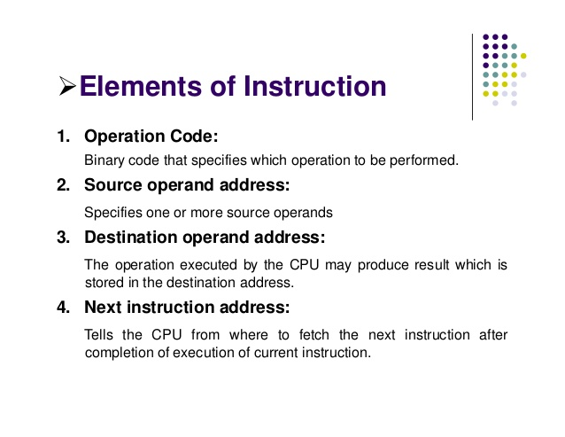

Slide 6
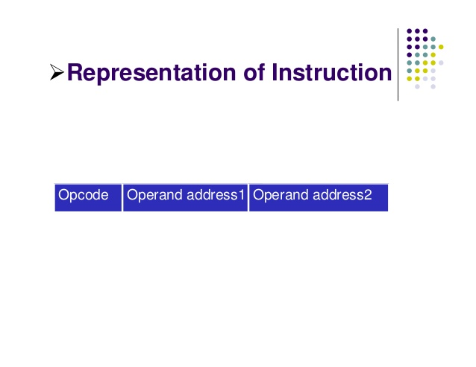

Slide 7
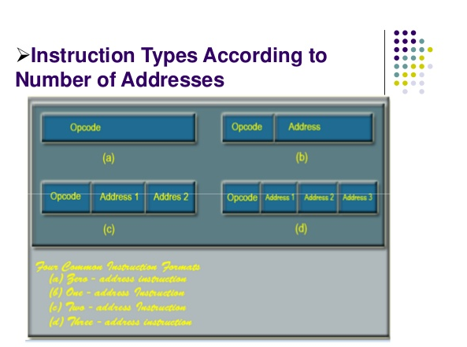

Slide 8
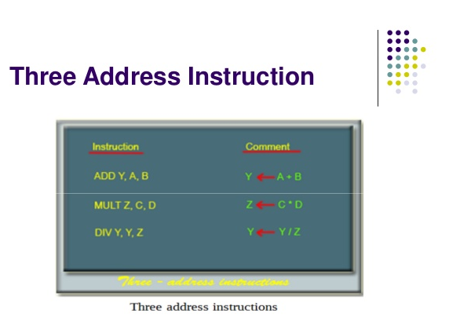

Slide 9
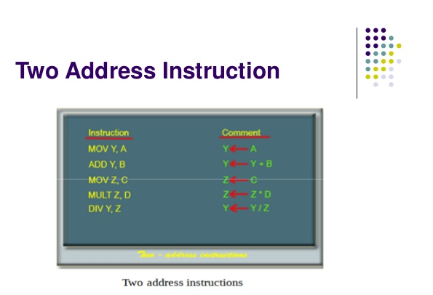

Slide 10
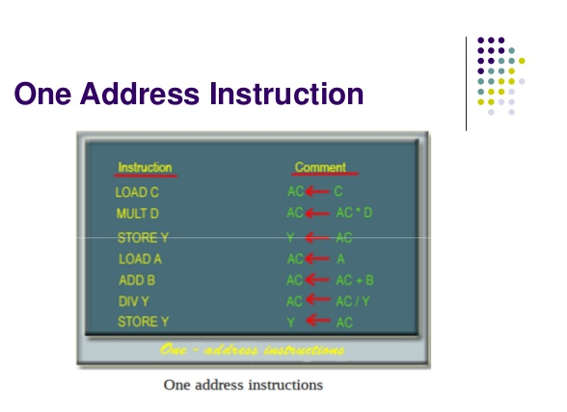

Slide 11
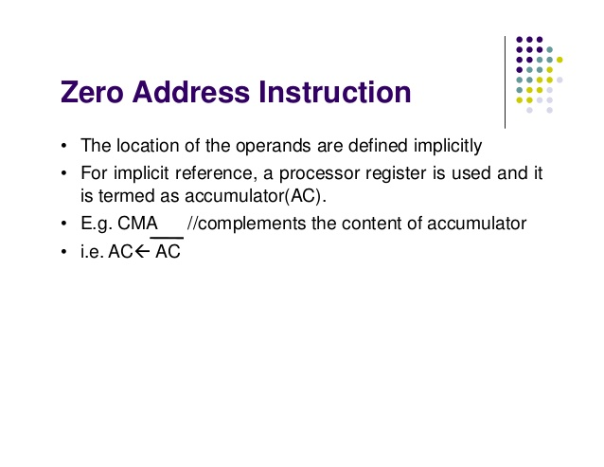

Slide 12
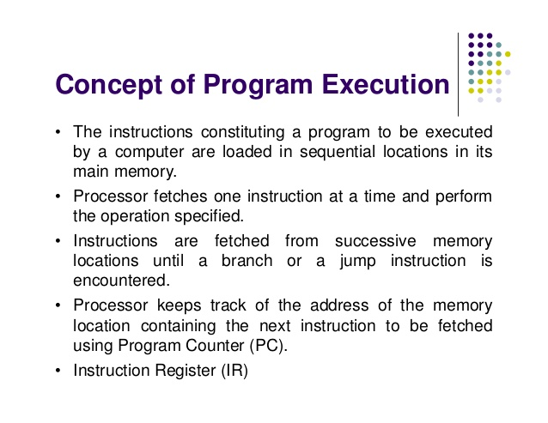

Slide 13
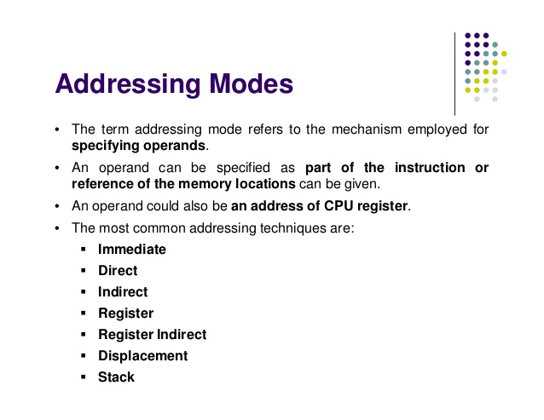

Slide 14
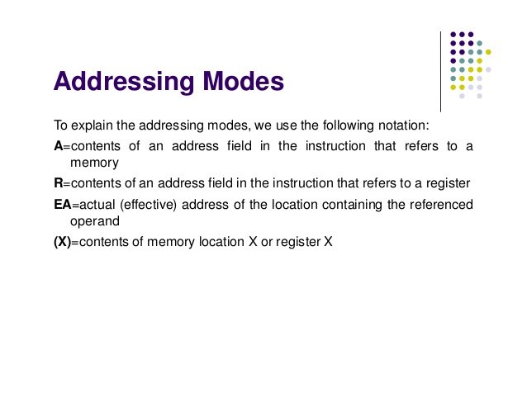

Slide 15
What is Addressing Mode?
Addressing modes are different ways by which CPU can access data or
operands.
They determine how to access a specific memory address. To load
any data from and to memory/registers, MOV instruction is used.
The syntax of MOV instruction is:
MOV Destination, Source
It copies the data of 2nd operand (source) into the 1st operand (destination).
To access memory, segment registers are used along with general-purpose
registers.

Slide 16
There are seven addressing modes in 8086 processor. Now, we will discuss all of them in detail with example assembly instructions.
1. Register addressing mode
2. Immediate Addressing Mode
3. Direct Addressing Mode
4. Register Indirect Addressing Mode
5. Based Relative Addressing Mode
6. Indexed Relative Addressing Mode
7. Based Indexed Addressing Mode

Slide 17
1. Register addressing mode
This mode involves the use of registers (general purpose). These registers hold the operands.
This mode is very fast as compared to others because CPU doesn’t need to access memory. CPU can directly perform an operation through registers.
For example:
MOV AX, BL
MOV AL, BL
The above two instructions copy the data of BL register to AX and AL.

Slide 18
Example Assembly Code
The ORG 100h is a directive which tells the compiler how to handle the source code.
ORG 100h
MOV AX,CX
ret
ORG 100 h sets the current address during assembly to be 100h. As initial 0-99h address locations are used up by the BIOS.

Slide 19
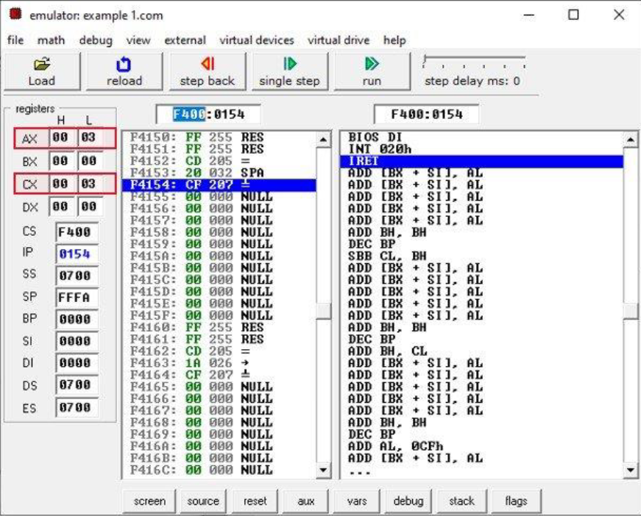
In this example, you can see a red box in the output. This red box indicates the content of AX and CX registers.
The content of both AX and CX registers are the same.
Because the above example moves the content of CX into AX register

Slide 20
2. Immediate Addressing Mode
In this mode, there are two operands. One is a register and the other is a constant value. The register comes after the op code.
For example:
The instruction MOV AX, 30H copies hexadecimal value 30H to register AX.
The instructions MOV BX, 255 copies decimal value 255 to register BX.
You cannot use the immediate addressing mode to load immediate value into segment registers. To move any value into segment registers, first load that value into a general-purpose register then add this value into segment register

Slide 21
Example Assembly Code
Let us suppose you want to store 320H into DS register.
ORG 100h
MOV AX,320H ;copies hexadecimal value 320h to AX
MOV DS, AX ;copies value of AX into DS
ret ;stops the program

Slide 22

If 0320h is added directly into the DS register using MOV instruction, the
compiler will generate an error.

Slide 23
3. Direct Addressing Mode
It loads or stores the data from memory to register and vice versa. The instruction consists of a register and an offset address.
To compute physical address, shift left the DS register (multiply by 10h) and add the offset address into it.

Slide 24
MOV CX, [481]
The hexadecimal value of 481 is 1E1. Assume DS=2162H then the logical address will be 2162:01E1.
To compute physical address, shift left the DS register and add it to offset address.
The physical address will be 21620H +1E1H=21801H.
Hence, after execution of the MOV instruction the contents of the memory location 21801H will be loaded into the register CX.
The instruction MOV [2481], CX will store the CX register content to memory location 21801H.

Slide 25
Example Code
ORG 100h
MOV AX, 2162H ;copies hexadecimal value 2162h to AX
MOV DS, AX ;copies value of AX into DS
MOV CX, 24 ;copies decimal value 24 into CX
MOV [481], CX ;stores the data of CX to memory address 2162:01E1
MOV BX, [481] ;load data from memory address 2162:01E1 into BX
RET ;stops the program

Slide 26
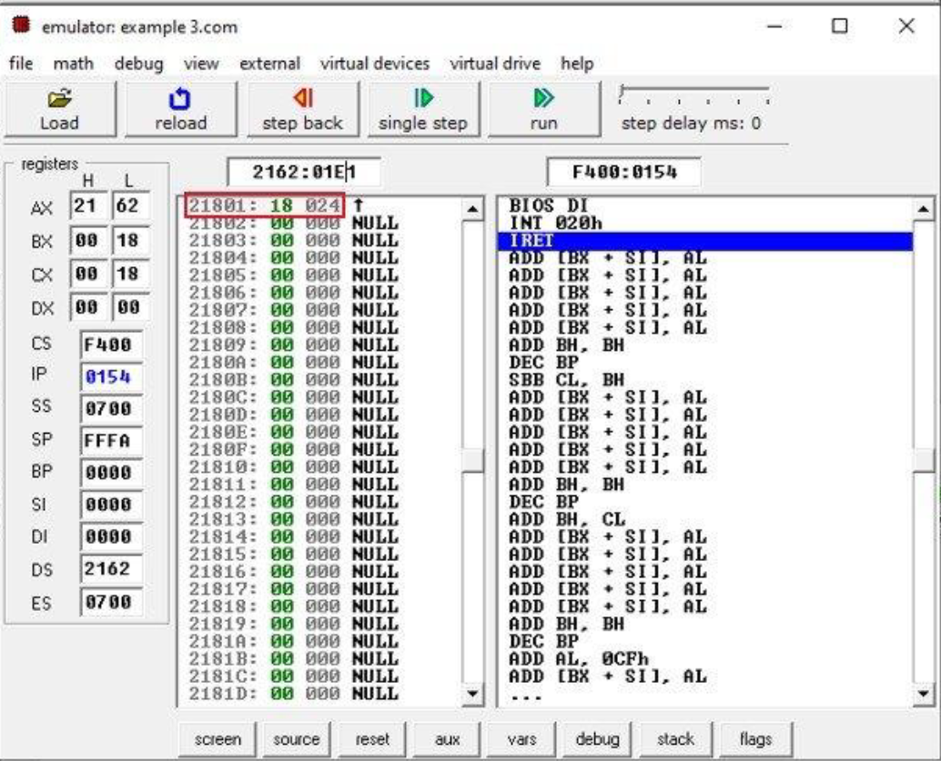
In this example, the red box indicates the hexadecimal value 18 and decimal
value 24 is stored at memory address 21801h

Slide 27
4. Register Indirect Addressing Mode
The register indirect addressing mode uses the offset address which resides in one of these three registers i.e., BX, SI, DI.
The sum of offset address and the DS value shifted by one position generates a physical address.
For example:
MOV AL, [SI]
This instruction will calculate the physical address by shifting DS to the left by one position and adding it to the offset address residing in SI.
The brackets around SI indicates that the SI contain the offset address of memory location whose data needs to be accessed.
If brackets are absent, then the instruction will copy the contents of SI register to AL. Therefore, brackets are necessary.

Slide 28
Example Code
ORG 100h
MOV AX, 0708h ;set AX to hexadecimal value of 0708h.
MOV DS, AX ;copy value of AX to DS
MOV CX, 0154h ;set CX to hexadecimal value of 0154h.
MOV SI, 42Ah ;set SI to 42Ah.
MOV [SI], CX ;copy contents of CX to memory at 0708:042Ah
RET ;returns to operating system

Slide 29
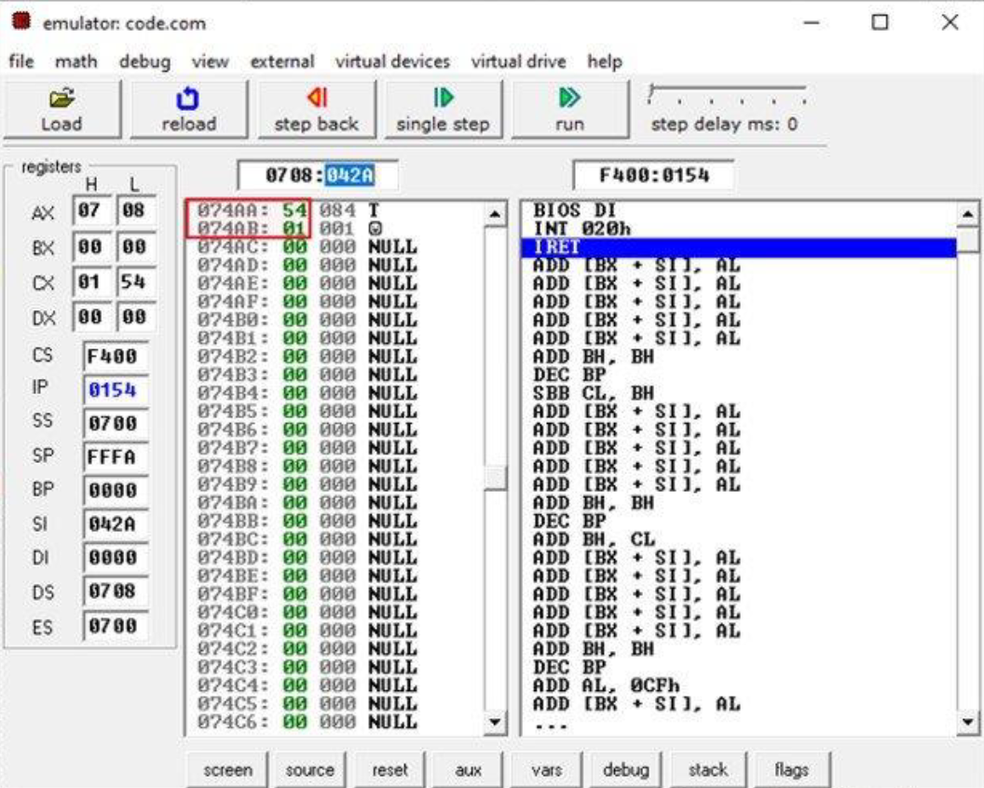
In the above example, the physical address is 07080 + 042A = 74AA.
According
to the little-endian convention, the 074AA will store the lowest bytes of data i.e.,
54 and the 074AB will store the most significant bits of data i.e. 01.

Slide 30
5. Based Relative Addressing Mode
This addressing mode uses a base register either BX or BP and a displacement value to calculate physical address.
Physical Address= Segment Register (Shifted to left by 1) + Effective address
The effective address is the sum of offset register and displacement value.
The default segments for BX and BP are DS and SS.
For example:
MOV [BX+5], DX
In this example, the effective address is BX + 5 and the physical address is DS (shifted left) + BX+5.
The instruction on execution will copy the value of DX to memory location of physical address= DS (shifted left) +BX+5

Slide 31
Example Code
ORG 100h
MOV AX, 0708h ;set AX to hexadecimal value of 0708h.
MOV DS, AX ;copy value of AX to DS
MOV CX, 0154h ;set CX to hexadecimal value of 0154h.
MOV BX, 42Ah ;set BX to 42Ah.
MOV [BX+5],DX ;copy contents of DX to memory at 0708:042Fh
RET ;returns to operating system

Slide 32
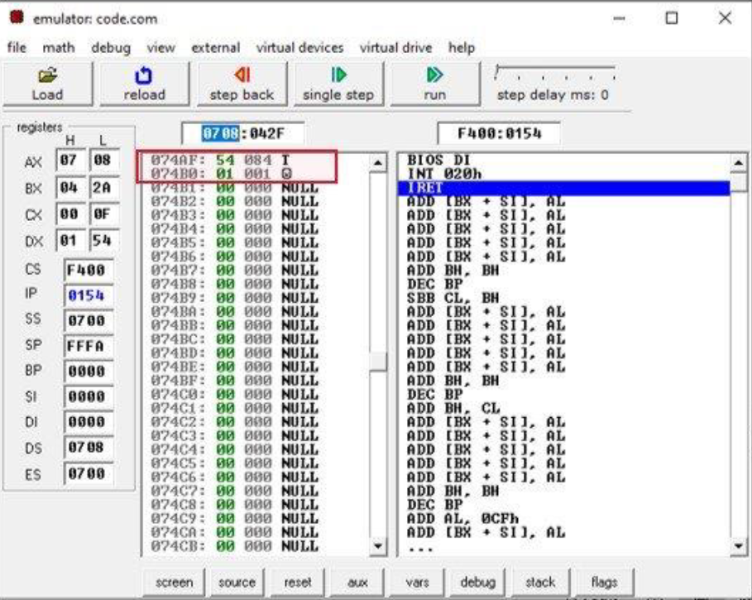

Slide 33
6. Indexed Relative Addressing Mode
This addressing mode is same as the based relative addressing mode. The only difference is it uses DI and SI registers instead of BX and BP registers.
For example:
Given that DS=704, SI = 2B2, DI= 145
MOV [DI]+12, AL
This instruction on execution will copy the content of AL at memory address 7197 (7040 + 145 + 12)
MOV BX, [SI]+10
This instruction will load the contents from memory address 7302 (7040 +2B2 + 10) to register BX.

Slide 34
7. Based Indexed Addressing Mode
The based indexed addressing mode is actually a combination of based relative addressing mode and indexed relative addressing mode. It uses one base register (BX, BP) and one index register (SI, DI).
For example:
MOV AX, [BX+SI+20]
The above instruction can also be written as:
MOV AX, [SI+BX+20]
Or
MOV AX, [SI][BX]+20

Slide 35
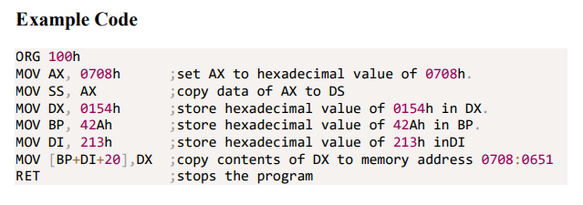

Slide 36
